Slide 1

Software requirements (swr302)
Beyond functionality
(chapter 14)

Slide 2
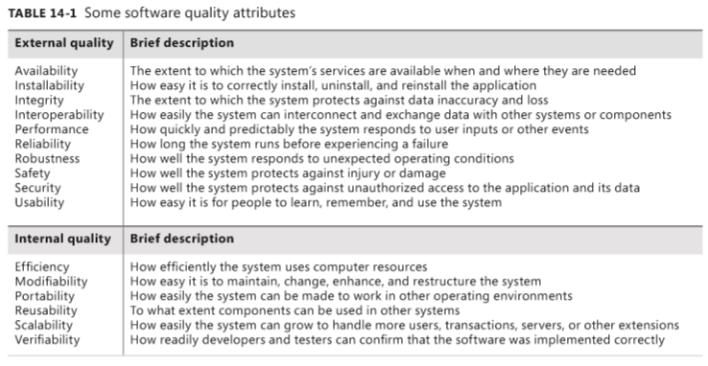
Software quality attributes

Slide 3
Exploring & Defining quality attributes
Exploring quality attributes
Step 1: Start with a broad taxonomy
Step 2: Reduce the list
Step 3: Prioritize the attributes
Step 4: Elicit specific expectations for each attribute
Step 5: Specify well-structured quality requirements
Defining quality requirements
External quality attributes: Availability, Installability, Integrity, Interoperability, Performance, Reliability, Robustness, Safety, Security, Usability,
Internal quality attributes: Efficiency, Modifiability, Portability, Reusability, Scalability, Verifiability

Slide 4
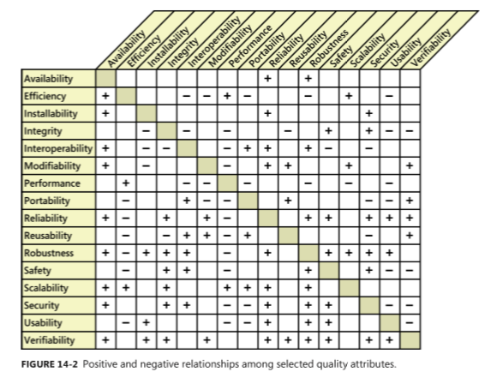
Quality attribute trade-offs

Slide 5
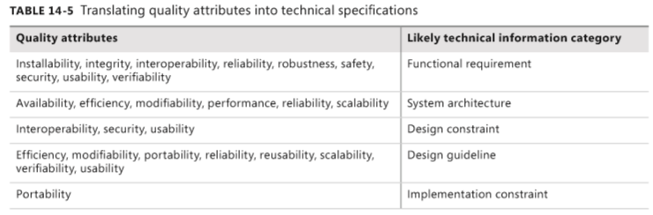
Implementing quality attribute requirements

Slide 6
Constraints
Definition
Purpose
Sources of constraints
Example
CON-1. The user clicks at the top of the project list to change the sort sequence. [specific user interface control imposed as a design constraint on a functional requirement]
CON-2. Only open source software available under the GNU General Public License may be used to implement the product. [implementation constraint]
CON-3. The application must use Microsoft .NET framework 4.5. [architecture constraint]
CON-4. ATMs contain only $20 bills. [physical constraint]
CON-5. Online payments may be made only through PayPal. [design constraint] CON-6. All textual data used by the application shall be stored in the form of XML files. [data constraint]

Slide 7
Handling quality attributes on agile projects
It can be difficult and expensive to retrofit desired quality characteristics into a product late in development or after delivery.
That’s why even agile projects that develop requirements and deliver functionality in small increments need to specify significant quality attributes and constraints early in the project.
This allows developers to make appropriate architectural and design decisions as a foundation for the desired quality characteristics.
Nonfunctional requirements need to have priority alongside user stories; you can’t defer their implementation until a later iteration.
Example

Slide 8


